Slide 1
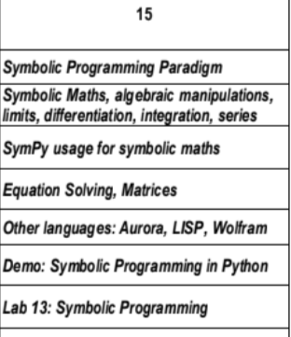
Symbolic Programing Paradigm- Unit5

Slide 2
Sympy-Symbolic Mathematics in Python
Symbolic Mathematics in Python
SymPy is a Python library used to represent the symbolic mathematics
SymPy is written entirely in Python and does not require any external libraries.
To Install the sympy use command : pip install sympy
Sympy support to perform the mathematical operations such as
Algebraic manipulations
Differentiation
Integration
Equation solving
& Linear algebra

Slide 3
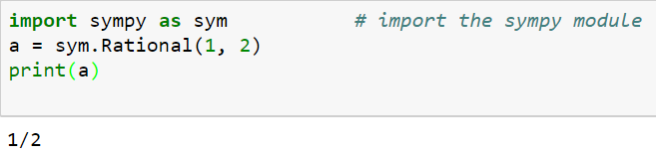
Ex1. To Find the rational no :
The Rational class represents a rational number as a pair of two Integers: the numerator and the denominator.
Rational(5, 2) represents 5/2.

Slide 4
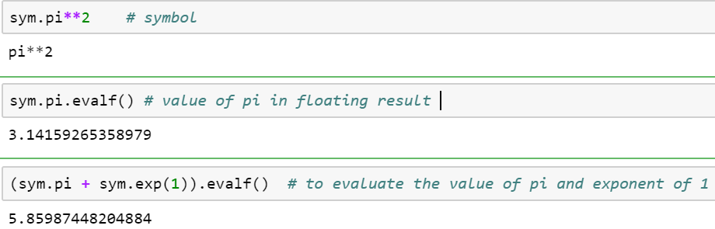
Some special constant e,pi,oo (Infinity) considered as symbol and evaluate the values. evalf evaluates the expression to a floating-point number.

Slide 5

2.Symbols:
In Computer Algebra Systems, in SymPy you have to declare symbolic variables explicitly:
Symbols() method also to declare a variable as symbol.
Then you can manipulate them:
>>> x + y + x - y
o/p
>>> 2* x

Slide 6
3. Calculus (differentiation and integration) :
Differentiation and integration can help us solve many types of real-world problems.
Derivatives are met in many engineering and science problems, especially when modelling the behaviour of moving objects.

Slide 7

3.Calculus
limit() in Python
With the help of sympy.limit() method, we can find the limit of any mathematical expression, e.g.,
Syntax: limit(expression, variable, value)
Parameters: expression – The mathematical expression on which limit opeartion is to be performed, i. e., f(x). variable – It is the variable in the mathematical expression, i. e., x value – It is the value to which the limit tends to, i. e., a.
Returns: Returns the limit of the mathematical expression under given conditions.

Slide 8
limit()-method
Ex:
# import sympy
from sympy import *
x = symbols('x')
expr = sin(x)/x;
# Use sympy.limit() method
limit_expr = limit(expr, x, 0)
print("Limit of the expression tends to 0 : {}".format(limit_expr))
Output:
Limit of the expression tends to 0 : 1

Slide 9
Differentiate in python you can differentiate any SymPy expression using diff() method.
Syntax : diff(func,var)
Example
from sympy import * # import sympy
x = symbols('x')
expr = 3*x**2+1
diff_expr = diff(expr, x)
print("The expression result is : {}".format(diff_expr))
O/p
The expression result is : 6*x

Slide 10
Series in Python
With the help of sympy.series() method, we can find the series of some mathematical functions and trigonometric expressions by using sympy.series() method.
Syntax : sympy.series()
Return : Return a series of functions
Example
from sympy import * # import sympy
x, y = symbols('x y')
# Use sympy.series() method
series_fun= cos(x).series()
print(series_fun)
O/p:
1 - x**2/2 + x**4/24 + O(x**6)

Slide 11

Integration in python
sympy.integrate() method
we can find the integration of mathematical expressions in the form of variables
syntax : sympy.integrate(expression, reference variable)
Return : Return integration of mathematical expression using sympy.integrate() method.
Ex1:
int_exp = sin(x)*exp(x)
intr = integrate(int_exp, x)
After Integration O/p is : exp(x)*sin(x)/2 – exp(x)*cos(x)/2
Ex2:

Slide 12
Algebraic manipulations
SymPy is capable of performing powerful algebraic manipulations.
Most frequently used algebraic manipulations are
expand and simplify.
expand() in python
we can expand the mathematical expressions in the form of variables by using sympy.expand() method.
Syntax : sympy.expand(expression)
Return : Return mathematical expression.

Slide 13
Example:
import sympy as sym
x=sym.Symbol('x')
y=sym.Symbol('y')
exp = sym.expand((x+y)**2)
print(exp)
O/p
x**2 + 2*x*y + y**2

Slide 14
simplify() in python
We can simplify any mathematical expression using simplify() method.
Syntax: simplify(expression)
Parameters: expression – It is the mathematical expression which needs to be simplified.
# import sympy
from sympy import *
x = symbols('x')
expr = sin(x)**2 + cos(x)**2
# Use sympy.simplify() method
smpl = simplify(expr)
print("After Simplification : {}".format(smpl))
O/p - After Simplification : 1

Slide 15
trigsimp() in python
We can simplify mathematical expressions using trigonometric identities.
Syntax: trigsimp(expression)
Parameters:
expression – It is the mathematical expression which needs to be simplified.
Example :
# import sympy
from sympy import *
x = symbols('x')
expr = sin(x)**2 + cos(x)**2
# Use sympy.trigsimp() method
smpl = trigsimp(expr)
print("After Simplification : {}".format(smpl))
O/p After Simplification : 1

Slide 16
solve() in python-SymPy solving equations
Equations are solved with solve() or solveset().
Ex:
import sympy as sym
x = Symbol('x')
eq1 = Eq(x + 1, 3)
sol = solve(eq1, x)
print(sol)
O/p
[2]

Slide 17
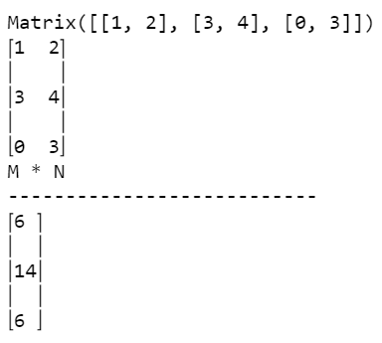
SymPy matrixes
In SymPy, we can work with matrixes. A matrix is a rectangular array of numbers or other mathematical objects for which operations such as addition and multiplication are defined.
Matrixes are used in computing, engineering, or image processing.
M = Matrix([[1, 2], [3, 4], [0, 3]])
print(M)
pprint(M)
N = Matrix([2, 2])
print("M * N")
print("---------------------------")
pprint(M*N)
O/p
--→

Slide 18
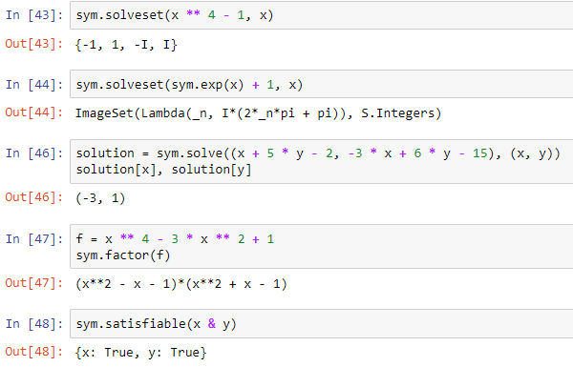
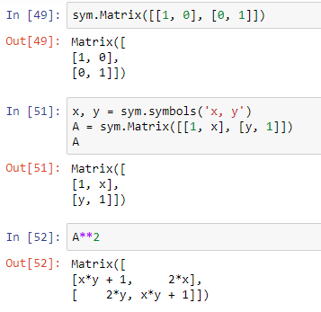
Example
Example:

Slide 19
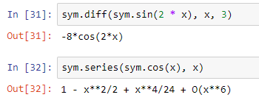
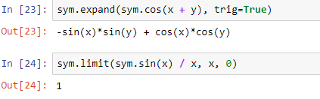
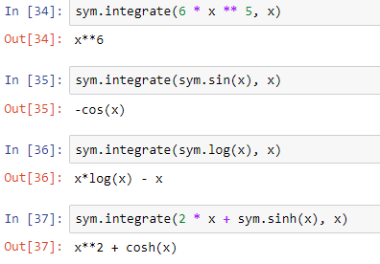
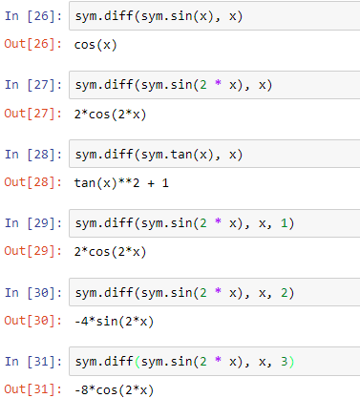
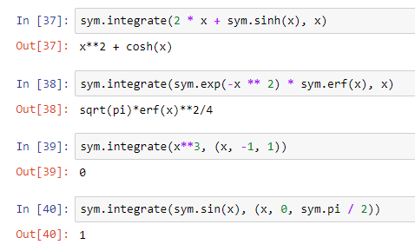
Example
Example:

